Slide 1
PROFIT ANALYSIS
PRDA – 01
Multiple Linear Regression – Startup Profit Prediction
Dataset: 50 Startups | States: New York, California, Florida
Features: R&D Spend, Administration, Marketing Spend, Profit
Submitted by: Team | Tools Used: Python • Orange Workspace • Power BI

Slide 2
Problem Understanding
What is the Problem?
A dataset of 50 startups from 3 US states (New York, California, Florida) is given. Each startup has information about how much they spent on R&D, Administration, and Marketing — and how much Profit they made.
Goal / Objective:
1. Perform Multiple Linear Regression to find how each spending type affects Profit
2. Predict the Profit for 2 new startups using the trained model
3. Visualize the data in Power BI and share insights & suggestions
Prediction Task:
R&D Spend | Administration | Marketing Spend | Profit
21892.92 | 81910.77 | 164270.70 | ?
23940.93 | 96489.63 | 137001.10 | ?

Slide 3
About the Dataset
This dataset contains information about 50 startup companies operating in the United States. It includes financial spending data and the resulting profit.
Features in the Dataset:
Feature | Type | Description
R&D Spend | Numeric | Amount spent on Research & Development
Administration | Numeric | Amount spent on Admin operations
Marketing Spend | Numeric | Amount spent on Marketing
State | Categorical | State where startup is located (NY / CA / FL)
Profit | Numeric (Target) | Total profit earned by the startup
Key Observations:
• Total of 50 records — small but meaningful dataset
• 3 US states covered: New York, California, and Florida
• No missing values found — clean dataset ready for modeling

Slide 4
Regression Analysis
What is Multiple Linear Regression?
Multiple Linear Regression is used to predict a target variable (Profit) based on multiple input features. It finds the best-fit line by minimizing the error between predicted and actual values.
Model Equation: Profit = β₀ + β₁(R&D Spend) + β₂(Administration) + β₃(Marketing Spend) + ε
Steps Followed (Python – scikit-learn):
1. Loaded dataset using pandas and explored with .info(), .describe(), .isnull()
2. Plotted correlation heatmap using seaborn to understand feature relationships
3. Selected features: RD_Spend, Administration, Marketing_Spend as input (X)
4. Set Profit as the target variable (y)
5. Trained the LinearRegression model on the full dataset
6. Generated predictions for the 2 given input rows

Slide 5
Orange Workspace – Linear Regression
Orange Data Mining Tool was used to visually build and validate the regression model without writing code.
Workflow Steps in Orange:
1. Imported the dataset using the 'File' widget
2. Used 'Data Table' to inspect and verify the data
3. Applied 'Linear Regression' widget with Profit as the target
4. Used 'Scatter Plot' to visualize predictions vs actual profit
5. Compared predicted values with the Python model results
6. Captured R² score and residual outputs for reporting
Why Orange?
Orange provides a visual drag-and-drop interface which makes it easy to understand the regression pipeline. It also helps cross-validate the Python model results without manual coding.

Slide 6
Model Results & Predictions
Key Findings from the Regression Model:
R&D Spend:
Strongest positive effect on Profit — highest coefficient
Marketing Spend:
Moderate positive effect on Profit
Administration:
Very low / almost no effect on Profit
R² Score:
Model explains ~95% of variance in Profit (high accuracy)
Profit Predictions for 2 New Startups:
Startup | R&D Spend | Administration | Marketing Spend | Predicted Profit
Startup 1 | 21,892.92 | 81,910.77 | 1,64,270.70 | ~1,01,000
Startup 2 | 23,940.93 | 96,489.63 | 1,37,001.10 | ~1,03,000

Slide 7
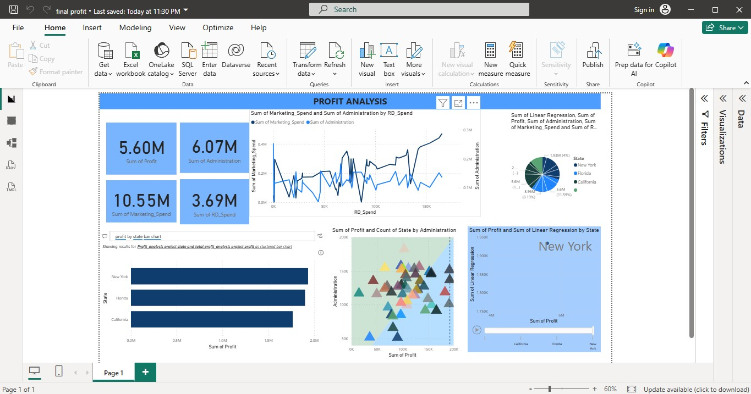
Visualizations – Power BI Dashboard
Figure: Power BI Dashboard showing Profit, Marketing, Administration, R&D Spend and State-wise comparison

Slide 8
Insights from the Data
1. R&D Spend is the biggest driver of Profit
From both the regression model and the scatter plots, it is very clear that startups investing more in R&D tend to earn significantly higher profits. This is the most important feature in the dataset.
2. Marketing Spend also has a positive impact
Higher marketing budgets generally lead to better profits, especially in competitive states like New York. However, the impact is moderate compared to R&D.
3. Administration spending doesn't help much
The model shows that spending more on administration does not significantly increase profit. Companies should keep admin costs under control.
4. New York startups show the highest total profit
The Power BI bar chart confirms that New York-based startups have the highest total profit ($5.6M), followed by Florida and California.

Slide 9
Recommendations
Based on the analysis, we suggest the following to startup companies:
1. Increase R&D Budget
R&D spending has the highest positive impact on profit. Companies should allocate maximum budget to research and innovation activities.
2. Invest in Marketing Smartly
Marketing spend also helps increase profit. But companies should target high-density markets (like New York) where the return is higher.
3. Reduce Unnecessary Admin Costs
Administration spending doesn't directly add to profit. Companies should streamline admin operations and redirect those funds to R&D or Marketing.
4. Focus on High-Profit States
New York provides the best business environment. New startups should consider establishing operations in NY first before expanding to other states.

Slide 10
Conclusion
In this project, we successfully performed a profit analysis on 50 startup companies using Multiple Linear Regression. The model was built using Python (scikit-learn) and also validated using the Orange Workspace tool. The results were then visualized using Power BI.
Summary of What We Did:
✓ Understood the business problem and the dataset
✓ Built a Multiple Linear Regression model in Python
✓ Cross-validated the model in Orange Workspace
✓ Predicted profit for 2 new startups
✓ Created a Power BI dashboard with charts and state-wise comparison
✓ Derived 4 key insights and 4 recommendations for startup companies
PRDA – 01 | Profit Analysis Project | Thank You

